Slide 1
Travelling to London
Notes:
There are a lot of places of interest in London which are worth seeing

Slide 2
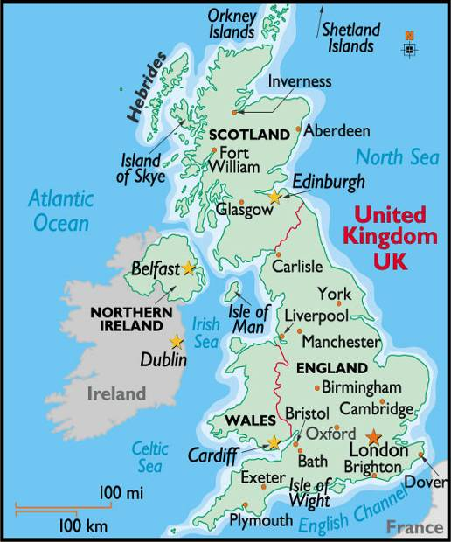

Slide 3
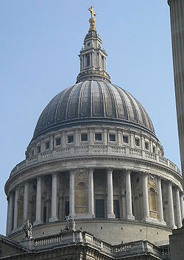
1
A) St Paul’s Cathedral
B) Westminster Abbey
C) Trafalgar Square
D) The Tower of London
E) The Houses of Parliament
Notes:
A) St Paul’s Cathedral
B) Westminster Abbey
C) Trafalgar Square
D) The Tower of London
E) The Houses of Parliament

Slide 4
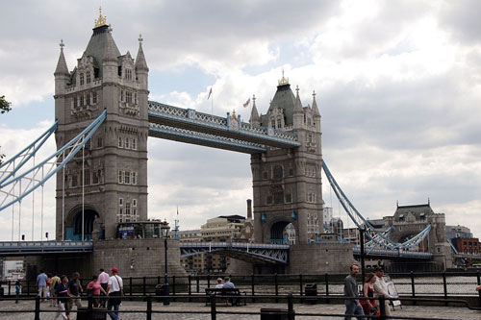
2
A) St Paul’s Cathedral
B) Westminster Abbey
C) Trafalgar Square
D) The Tower of London
E) The Houses of Parliament
Notes:
A) St Paul’s Cathedral
B) Westminster Abbey
C) Trafalgar Square
D) The Tower of London
E) The Houses of Parliament

Slide 5
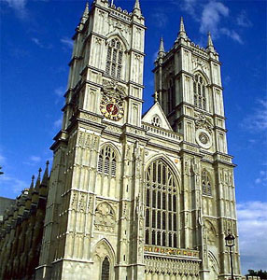
3
A) St Paul’s Cathedral
B) Westminster Abbey
C) Trafalgar Square
D) The Tower of London
E) The Houses of Parliament
Notes:
A) St Paul’s Cathedral
B) Westminster Abbey
C) Trafalgar Square
D) The Tower of London
E) The Houses of Parliament

Slide 6
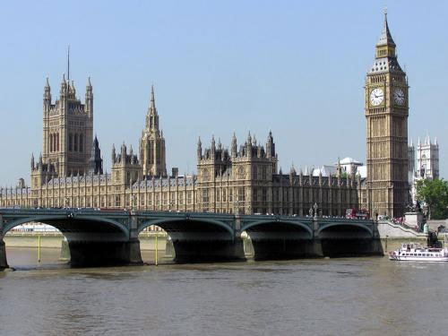
4
A) St Paul’s Cathedral
B) Westminster Abbey
C) Trafalgar Square
D) The Tower of London
E) The Houses of Parliament
Notes:
A) St Paul’s Cathedral
B) Westminster Abbey
C) Trafalgar Square
D) The Tower of London
E) The Houses of Parliament

Slide 7
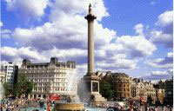
5
A) St Paul’s Cathedral
B) Westminster Abbey
C) Trafalgar Square
D) The Tower of London
E) The Houses of Parliament
Notes:
A) St Paul’s Cathedral
B) Westminster Abbey
C) Trafalgar Square
D) The Tower of London
E) The Houses of Parliament

